Slide 1

Autism meeting
Process, infrastructure and scope of coverage
Date : 11th Dec 2017
Venue : DMS, Chennai

Slide 2
General introduction about the scheme
INTRODUCTION:
The Honorable Chief Minister’s Comprehensive Health Insurance scheme was renewed and re-launched on 11th January 2017.
The main objective of the scheme is to enable access to health care for the lower income sections of the society.
The enrolment is limited to families whose annual income is less than INR 72,000.
Multimodal therapy for Autism was launched by the Honorable Minister under the scheme on 22nd May 2017.

Slide 3
General introduction about the scheme
ELIGIBILITY:
The eligibility criterion defined for availing the benefits of the scheme is “any family whose annual income is INR 72,000 or less” as certified by the Village Administrative Officer (VAO),and the spouse, children and dependent parents of such members in urban and rural areas.
The term eligible family includes the eligible member and his or her family, which includes
1. The legal spouse,
2. children of the eligible person till they get employed or married or attain the age of 25 years, whichever is earlier, and who are dependent on the eligible person, and
3. Dependent parents of the eligible person.

Slide 4
General introduction about the scheme
SALIENT FEATURES:
The scheme enables the enrolled families to derive a maximum benefit of INR 4 lakh over 4 years (INR 1 lakh in each year); it has a provision to avail benefits up to INR 2 lakh for certain procedures (like renal transplantation, cochlear implant surgery ,liver transplantation, Heart and lung transplantation, etc.)
Coverage of Treatment:
The scheme presently covers the expenses incurred for 1,027 tertiary care procedures under different specialties.
Out of 1,027 procedures covered under the scheme, some procedures are covered up to INR 1 lakh; some up to INR 2 lakh for high-end procedures

Slide 5
Autism Spectrum Disorders
Infrastructure and scope of coverage

Slide 6
BASIC guidelines for autism package utilization
The Private centres providing Autism care may be any of the following with Minimum five year experience
        PWD & National Trust Act registered NGO’s
        Special Schools
        Residential special school
Documentation to be submitted:
        Society registration/renewal
        80G/12A
        List of beneficiaries
        Annual report
        Details of infrastructure
        Details of staff / professionals

Slide 7
BASIC guidelines for autism package utilization(conti..)
Infrastructure:
  Minimum 5 rooms of 200 sq. exclusively for session based clinical service
  Barrier free access toilet,
  Drinking water
  Fire safety
  Equipment to provide Occupational therapy and Physiotherapy,
  Speech Therapy materials (Flash cards / Games / Work Sheets),
  Training materials for Special Education (visuals / Fidgets / Therapy Balls)
  Psychology / ICT materials

Slide 8
BASIC guidelines for autism package utilization(conti..)
Services to be provided under the Scheme:
    Special Education
    Occupational Therapy
    Developmental Therapy
    Speech & Language Therapy
    Psychological services
    Physiotherapy
Professional Requirement:
    Psychiatrist
    Paediatrician
    Psychologist
    Occupational therapist
    Speech therapist
    Social worker

Slide 9
BASIC guidelines for autism package utilization(conti..)
Scope of Coverage
    Coverage for Autism includes therapies such as Special Education,
    Physiotherapy,
    Occupational Therapy,
    Speech & Language Therapy,
    Developmental Therapy,
    Psychological Services, etc.

Slide 10
Steps to login to the CMCHISTN application
Enter www.cmchistn.com in any recommended browser.
Move the cursor over Hospital tab and select Claim from the drop down option.
(or)
Type the below URL in search bar of the browser
https://claim.cmchistn.com

Slide 11
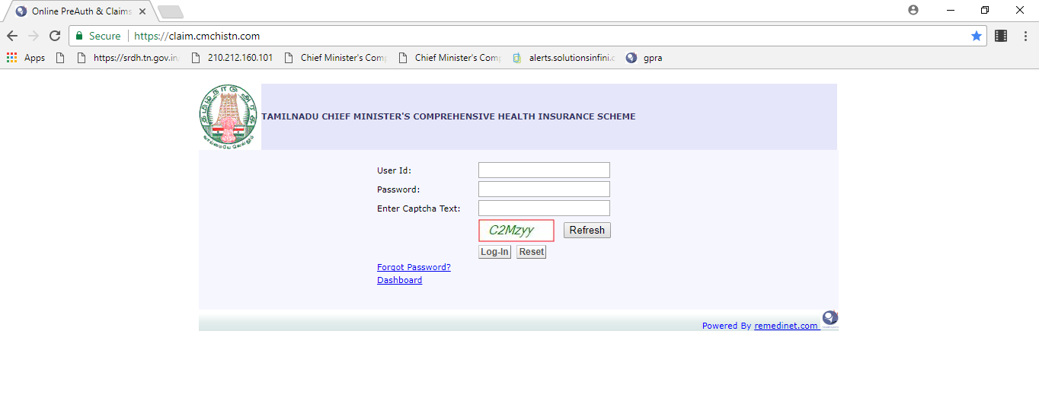
Login steps(Conti..)
User Id’s and Password been given for all user’s with their appropriate roles.

Slide 12
Login Steps(conti…)
Enter the User Id
Enter the Password
Enter the captcha code
Click the Login button

Slide 13
INSurance coordinator
Roles and Responsibilities

Slide 14
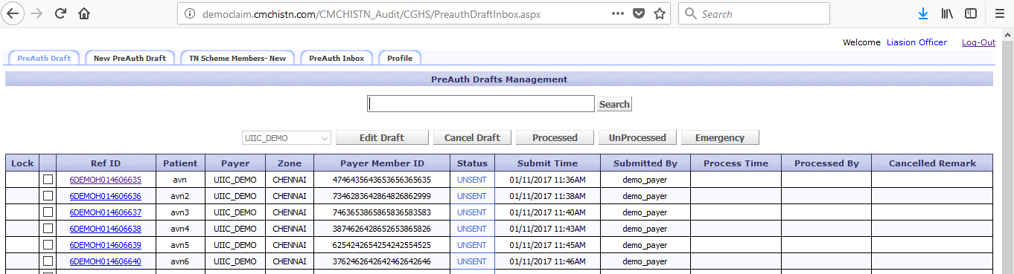
Insurance Coordinator Roles
After successful login from LO’s id the user will be directed to below page.

Slide 15
Insurance Coordinator Roles(Conti..)
This page contains the following tabs,
          Preauth Draft
          New Preauth Draft
          TN Scheme Members-New
          Preauth Inbox
          Profile

Slide 16
Insurance Coordinator Roles(Conti..)
PreAuth Draft:
The Draft which should be submitted to DMO will be available here.
This page contains the following options,
Edit Draft: The existing Preauth information can be modify from this option.
Cancel Draft: The PreAuth draft which are created can be cancel using the cancel draft option.
Processed: This will list the PreAuth draft which are submitted for processing Preauth.

Slide 17
Insurance Coordinator Roles(Conti..)
UnProcessed : This will list the preauth draft which submitted to DMO end.
Emergency : This option will show the emergency drafts for which the preauth should arise.
New PreAuth Draft:
In this section the user can enter the patient demographic details(address,age,patient IP no and Referred type)

Slide 18
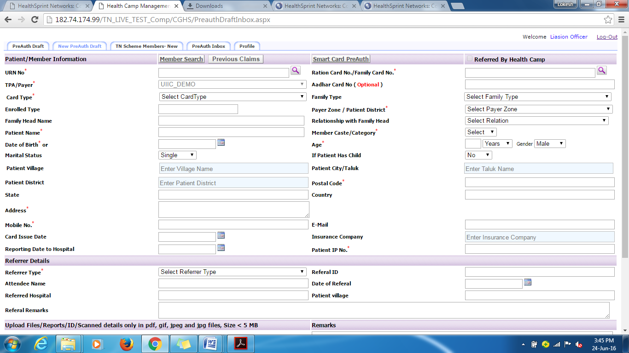

Slide 19
Steps to be followed:
Enter the URN no
Enter the Patient Ration card no
Enter the Aadhar card no if available
Select the Smart card Type
Select the Family Type
Enter the enrolled Type
Select the payer Zone
Enter the Family head Name
Enter the relationship of the member with the main policy holder in the Relation with Main Member /Policy
Enter the Patient Name
Select Member Caste/Category
Enter age of the member at the time of draft creation the Member Age (At Application Time) box.
Enter the date of birth in Date of Birth box, or click icon >select your date of birth.
Click the Member Gender dropdown arrow>select the gender of the member.
Enter the address of the member in the Member Address box.
Click the Village dropdown arrow>select the village (residential location)of the member.
Enter the city of residence of the member in the Member City box.
Enter the pin code of the city in the Pin code box.
Enter the state of residence of the member in the Member State box.
Enter the country of residence of the member in the Member Country box.
Enter the telephone number of the member in the Member Telephone No.
Enter the Email id of the member in the Member Email box.
Select the card Issue date
Select the Reporting date of hospital
Enter the Patient IP no
Select the referrer Type
Enter the attendee name
Enter refer id
Referred hospital
Referral id
Referral Remarks
Upload the scanned documents

Slide 20
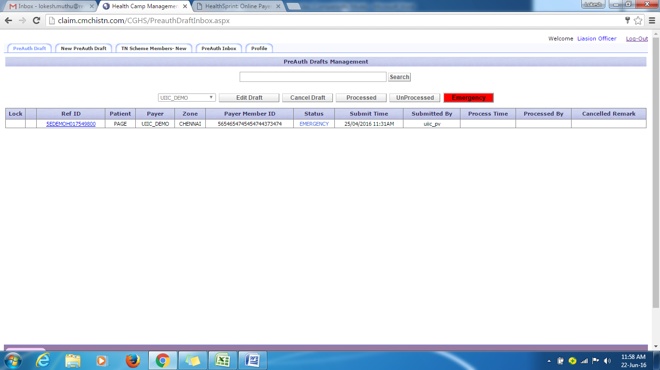
Emergency Draft in normal draft page
Once the Emergency draft created in Emergency Liaison officer id which will reflect in normal preauthorisation Login page.
Separate Tab is been provided to show emergency ref id’s.

Slide 21
Dedicated medical officer
Roles and Responsiblities

Slide 22
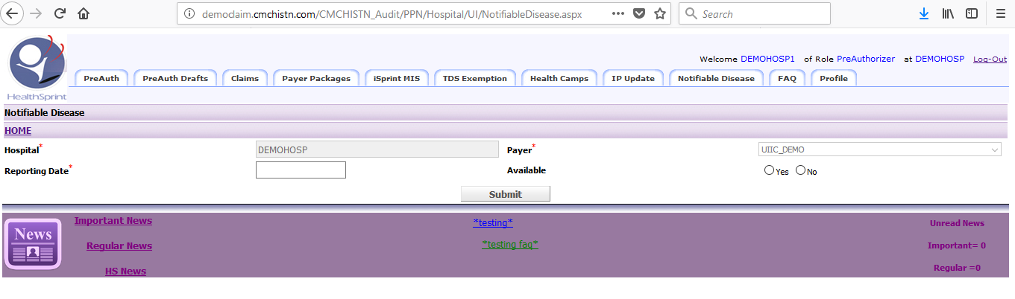
DMO’s Roles
After Successful login from DMO’s ID the user will be directed to the below page.

Slide 23
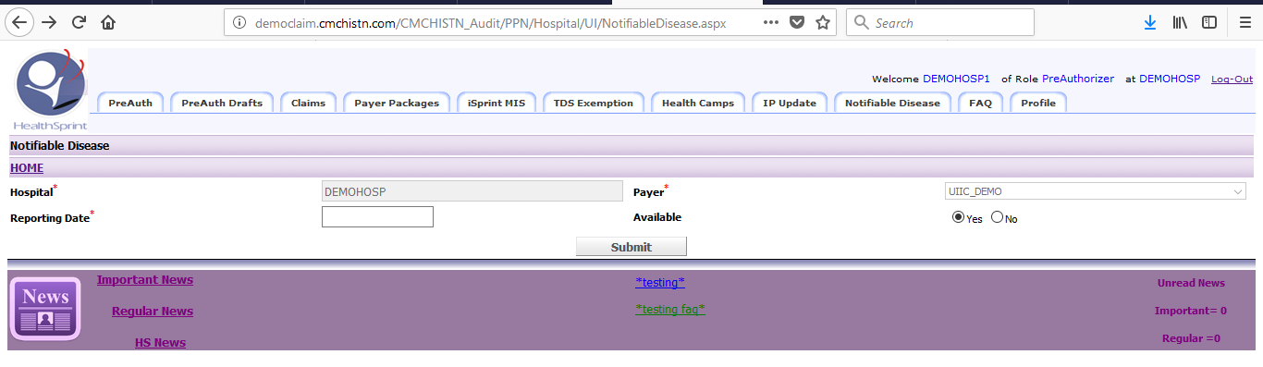
DMO’s Roles
The DMO have to submit the Notifiable disease if existing for any patient treated at their hospital.
    If patient is identified with notifiable disease, follow the below steps:
        select the date and click yes.
        The list of diseases will generate.
        Select the available disease and click submit.

Slide 24
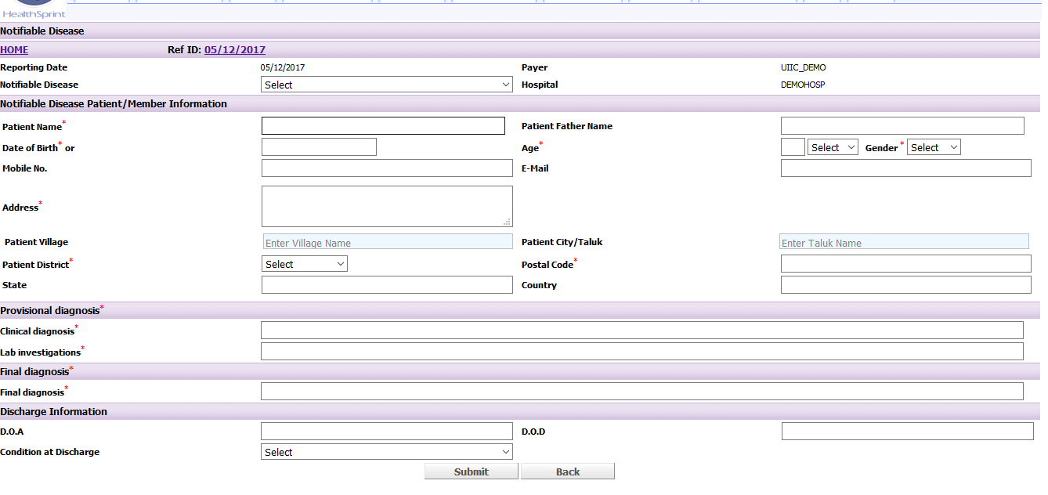

Slide 25
Steps to be followed to submit patient details.
Select the notifiable disease from the given drop down.
PATIENT INFORMATION DETAILS:
Enter the patient Name
Enter the Patient father name
Enter the Date of Birth (or) Age
Enter the years(if age details given)
Select the gender from the given drop down

Slide 26
Steps to be followed to submit patient details (Conti..)
  Enter the 10 digit mobile number
  Enter the E-mail id
  Enter the Patient Address
  Enter the Patient village
  Enter the Patient city/taluk
  Enter the Patient District
  Enter Postal code
  Enter State
  Enter Country
  Enter clinical diagnosis
  Enter Lab investigation
  Enter Final Diagnosis

Slide 27
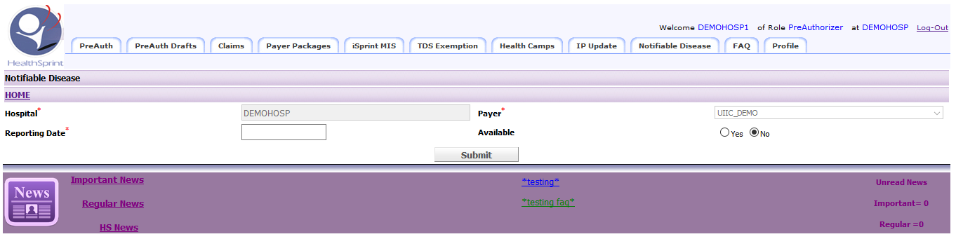
Steps to be followed to submit patient details (Conti..)
Enter Date of Admission(DOA)
Enter Date of Submission
Enter condition at Discharge
Click Submit button.
If No patient is diagnosed with notifiable disease then select ‘No’ in Available and submit.

Slide 28
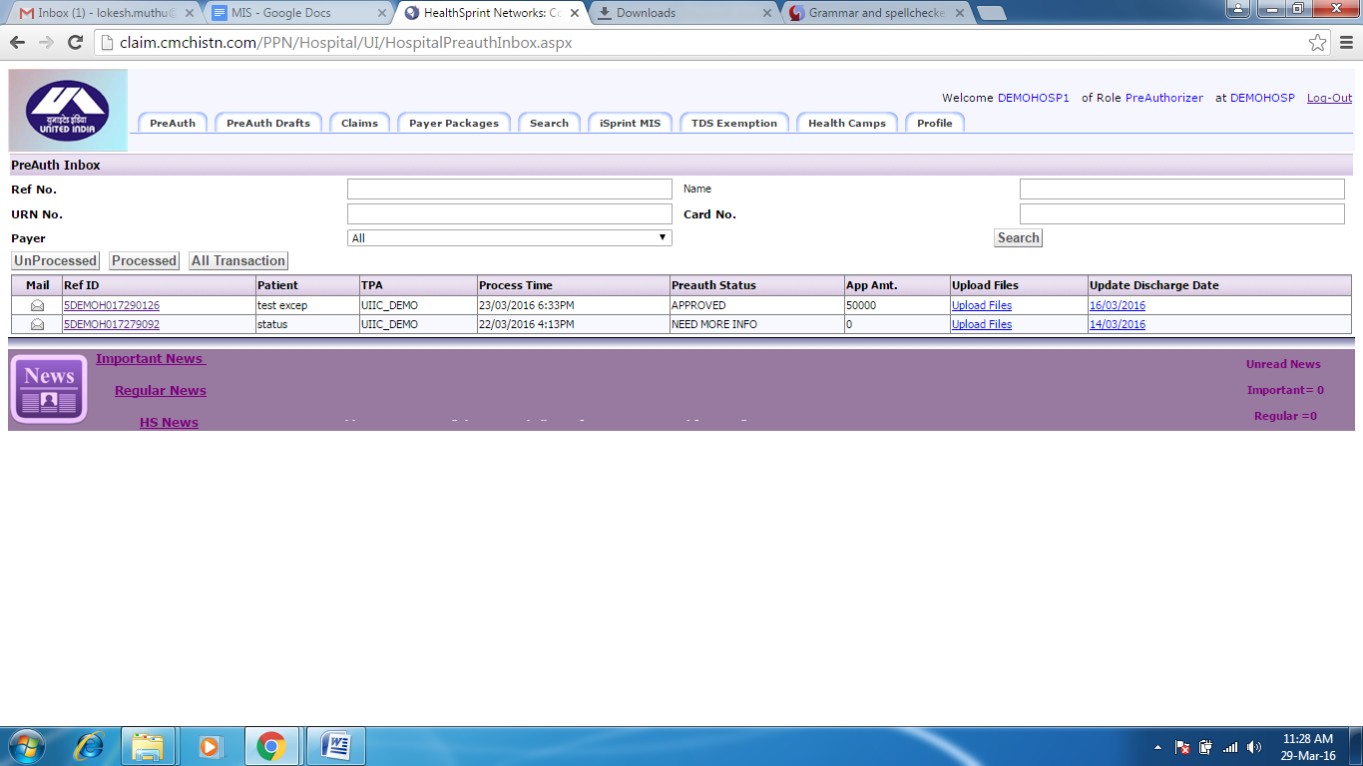
DMO(Preauthorization)
After Submitting the Notifiable disease details, the user can able to submit the Preauth and claims.

Slide 29
DMO(Preauthorization) (conti..)
The DMO page contains the following tabs:
Preauth
Preauth Draft
Claims
Payer Packages
Search
iSprint MIS
TDS Exemption
Health Camps
Profile

Slide 30
DMO(Preauthorization) (conti..)
PreAuth tab:
The Preauth which are submitted for processing and the processed preauth will reflect in PreAuth tab.
This PreAuth tab contains the following Sub tabs;
UnProcessed->The Preauth which are yet to be processed will appear here.
The User can able to cancel the unprocessed Preauth.

Slide 31
DMO(Preauthorization) (conti..)
Processed-> The Preauth’s which are processed from the approver end will reflect here.
Preauth Status:
1.Approved
2.Need more Info
3.Enhanced
4.Enhanced denied

Slide 32
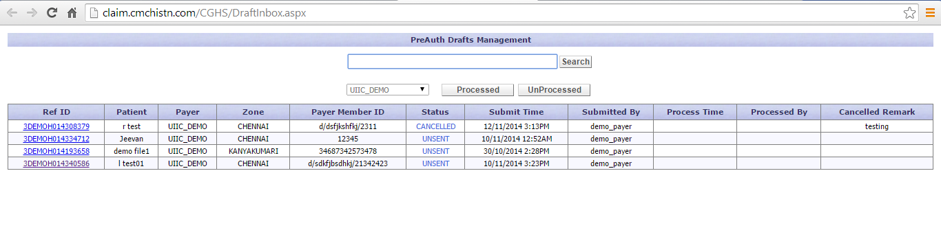
DMO(Preauthorization) (conti..)
All Transaction->It will reflect both unprocessed and processed Preauth cases.
PreAuth Draft:
Unprocessed->The Preauth drafts which insurance coordinates submitted from their end will reflect here.
Different Tab are available to show the appropriate about the draft.
Status of the draft will be shown.

Slide 33
DMO(Preauthorization) (conti..)
Click the Preauth Drafts for processing the draft from LO draft.
STEPS TO BE FOLLOWED TO SUBMIT THE PREAUTH:
1.Enter the chief complaint and admission ailment
2.Enter the patient medical history
3.Duration of Patient ailment

Slide 34
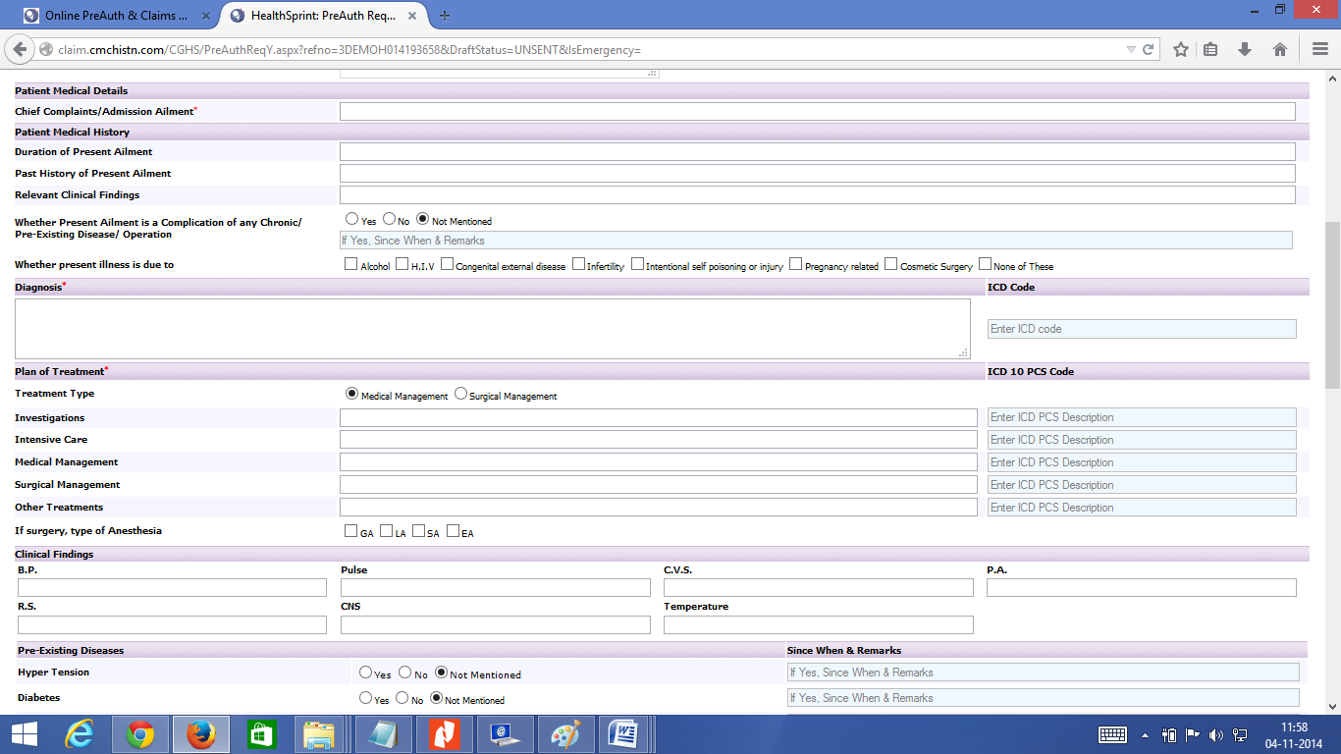

Slide 35
DMO(Preauthorization) (conti..)
4.Past history of present ailment
5.Relevant clinical findings
6.Click whether present ailment is a complication of any chronic (or)
7.Pre- Existing Disease / Operation
8.Click whether present illness is due to
Alcohol
H.I.V
Congenital external disease and etc.

Slide 36
DMO(Preauthorization) (conti..)
9.Enter the Diagnosis for the patient
6.Enter the Plan of treatment
Medical or surgical
->Treatment type
->Investigation
->Intensive care
->Surgical Management
->Other Treatment
If surgery type of anesthesia
7.Select the pre-existing disease (if any), enter the duration since when the member is Suffering from the disease in the boxes and enter their marks in the Remarks box.

Slide 37
DMO(Preauthorization) (conti..)
8. Select whether the member has a Consanguineous Marriage.
9. Select the alcohol and smoking information
10. Fill the hospital details
-Select the date of admission
- Select expected discharge date
- Enter Room ward type
- Enter Treating doctor name
- Select doctor Specialization
- Expected Date of surgery
- Enter Doctor registration no
11. Select the Treatment/Procedure code
12. Enter the High Risk consent remarks and conseling doctor remarks.

Slide 38
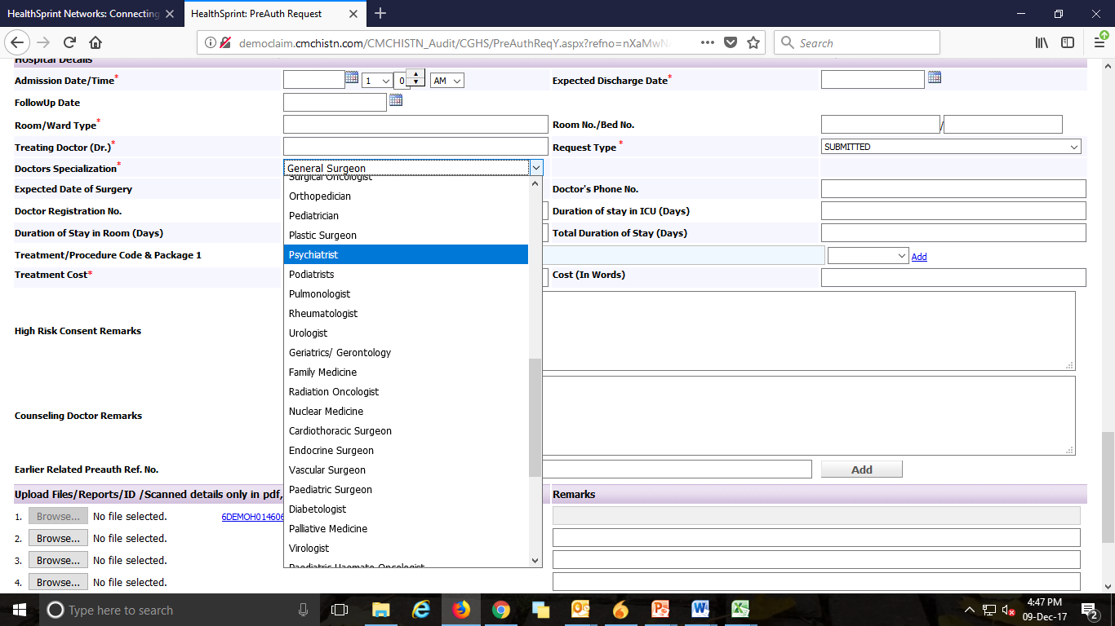

Slide 39
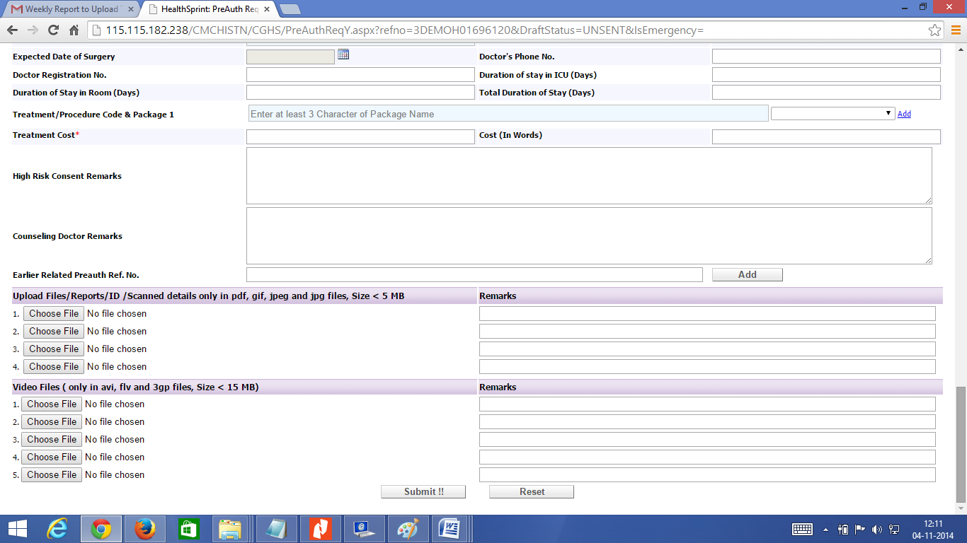
DMO(Preauthorization) (conti..)
Upload ID/Report Details
In this section the user can upload any proof of identity, medical test reports or any other diagnostic reports.

Slide 40
Autism-Preauth:
Following are the documents to be attached in Autism Preauth Submission
Preauthorisation form with complete plan of management.
Photograph of the patient taken in the institute.
Disability certificate.
Psychiatrist assessment and final report based on one of the following
  Indian Scale for Assessment of Autism (ISAA)
  Childhood Autism Rating Scale (CARS)
  Diagnostic and Statistical Manual- 5 (DSM V)
Assessment of a holistic internal team (comprising Clinical psychologist, Paediatrician, Special educator, Speech therapist, Occupational therapist, Physiotherapist) and certified by district Psychiatrist.
Therapy plan on a monthly basis.

Slide 41
DMO(Preauthorization) (conti..)
Click the Browse button.
Choose the file which has to be uploaded.
Enter remarks about the document in the Remarks box.
Click the Submit button.

Slide 42
CLAIMS
DMO Claim submission:
After the Preauth is approved, the case with reference id will be reflected in the claim module. The case which has to claim and the case which are already claimed are visible in different tab.
The user can able be search the case directly with either reference id or name, payer and claim status.
There are four sub categories in claims modules.
Unsubmitted
Submitted
Unprocessed
processed

Slide 43
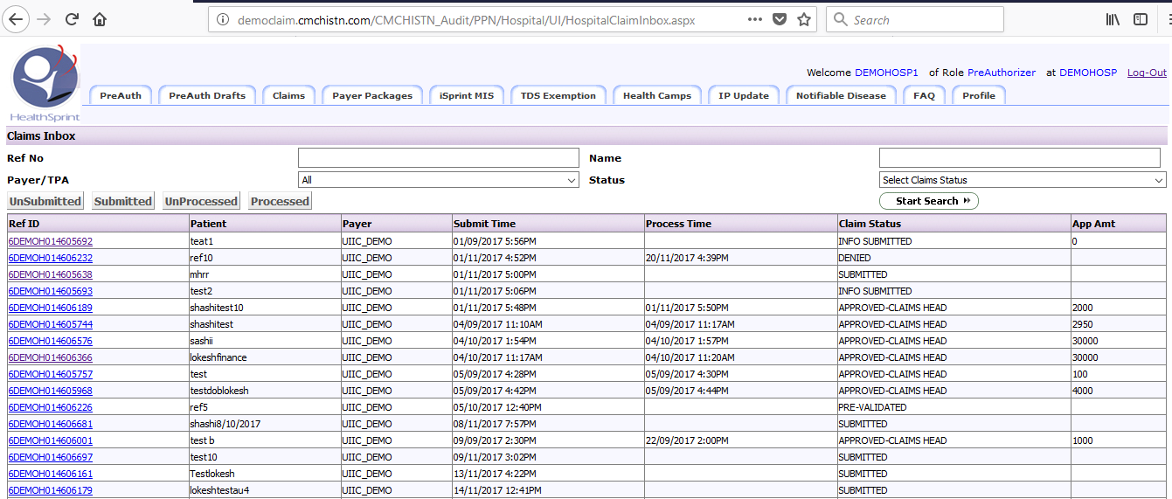
CLAIMS

Slide 44
CLAIMS
UNSUBMITTED: The approved Preauth cases which are yet to be submitted for claim will reflect here.
Steps to Submit the claim:
Click the reference id which needs to be processed.
Some of the fields will already filled and freezed in the application page.
Follow the below steps,
1.Enter the remaining patient information.
2.Click whether the implant is used for the patient.

Slide 45
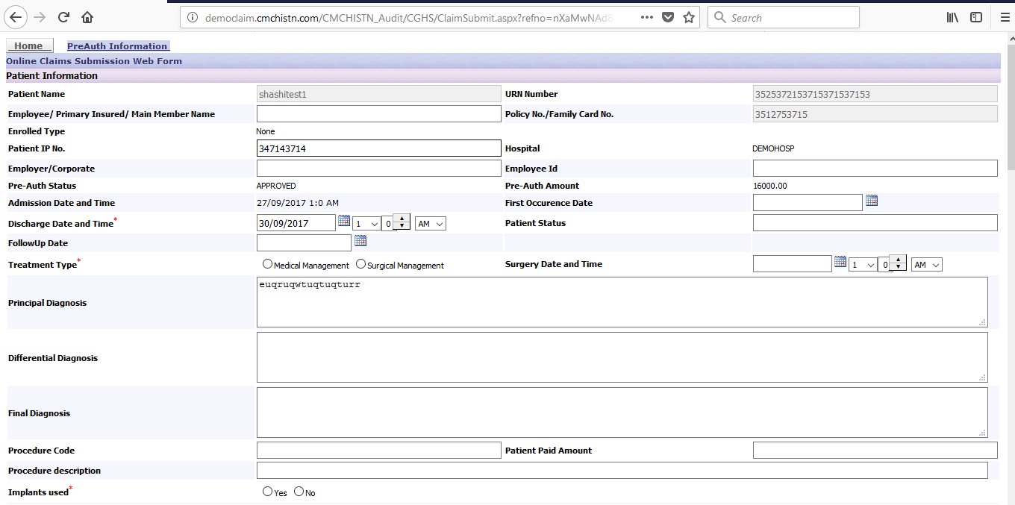

Slide 46
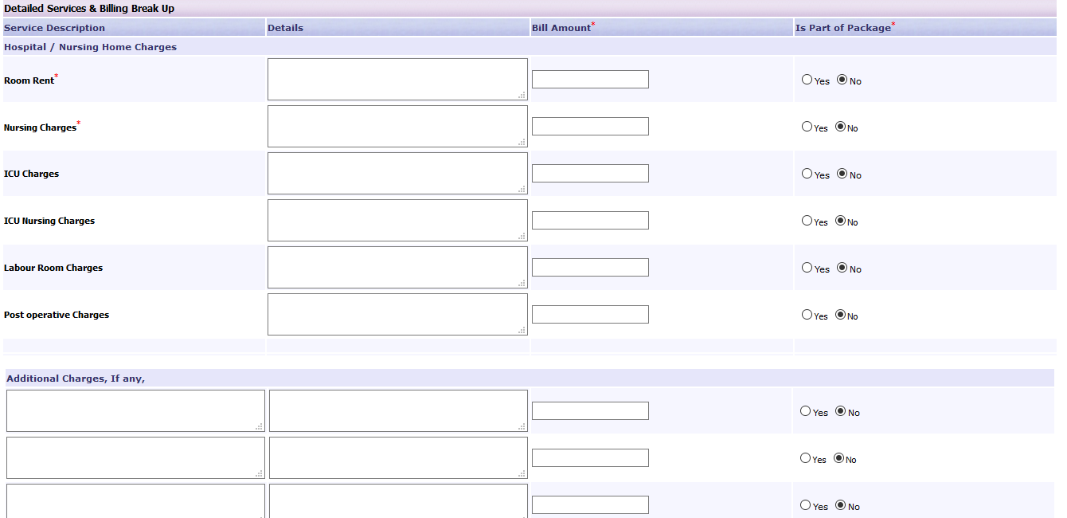
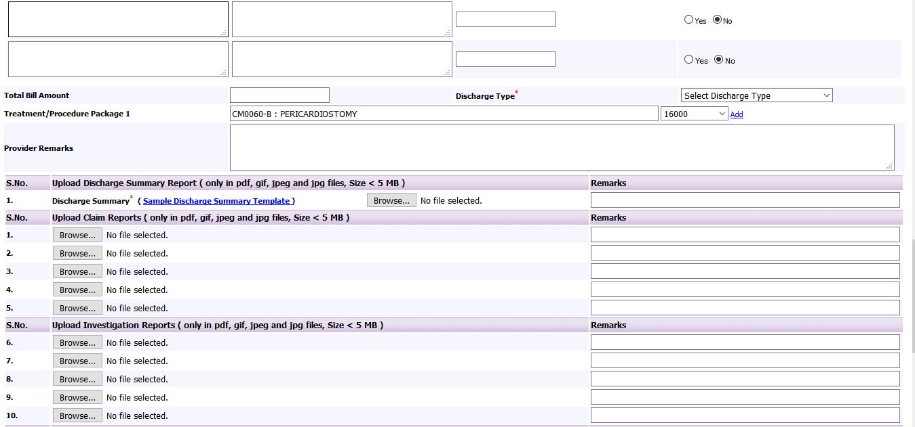

Slide 47
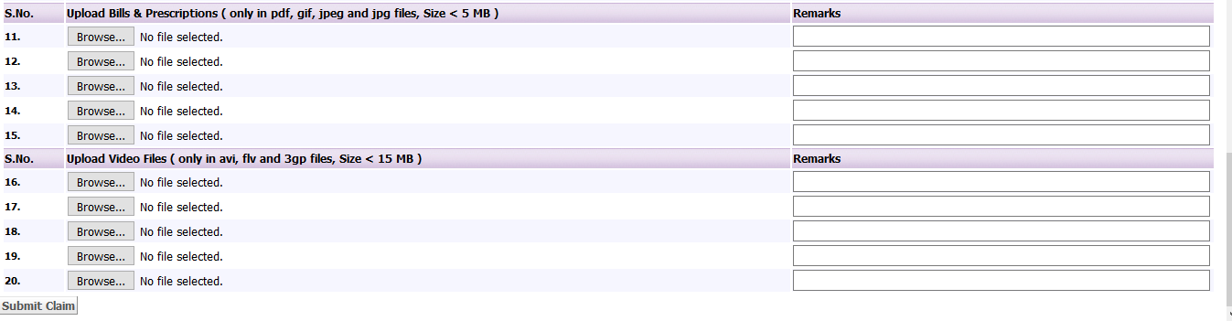

Slide 48
Steps to submit the claim(conti..)
Enter the Bill Amount for the following,
1.Room Rent
2.Nursing Charges
3.ICU Charges
4.ICU Nursing Charges
5.Labour Room Charges
6.Post operative Charges and
7.Additional Charges, If any
Then select ‘Yes’ if any of the amount entered above was part of the package amount.
Enter the total bill amount
Select the Discharge type.
User can add the additional package for the treatment by clicking ‘Add’ link in the Treatment/Procedure Package 1 field.

Slide 49
Steps to submit the claim(conti..)
Autism -Claim:
Following are the documents to be attached while submitting Autism claim
  Summary of treatment of the month containing
  Therapy reports – for all therapy sessions
  Observations of the therapist for each session
  Monthly assessment & progress report.
  Quarterly review report.
  Annual review report.

Slide 50
Steps to submit the claim(conti..)
UPLOADING DOCUMENTS:
The files which are need to be uploaded should be only be in following format
1.Pdf
2.Gif
3.Jpeg
4.Jpg
The file Size should be less than 5 MB.
For Videos files,the file should be in avi,flv,3pg format with less than 15 MB.
After uploading the needed files click the Submit Claim button to submit the claim.

Slide 51
Claims
SUBMITTED TAB: The claims which are submitted for process will appear here.
UNPROCESSED : The claim which are submitted and yet to be processed from approver end will reflect here.
User can able to edit the submitted claim in unprocessed tab by clicking ReSubmit button.
PROCESSED: Claims which are Approved will reflect here.
Status of Claims;
  Submitted
  Pre validated
  Need more info
  Info Submitted
  Reconsider
  Approved
  Denied
  Approved Claims Head

Slide 52
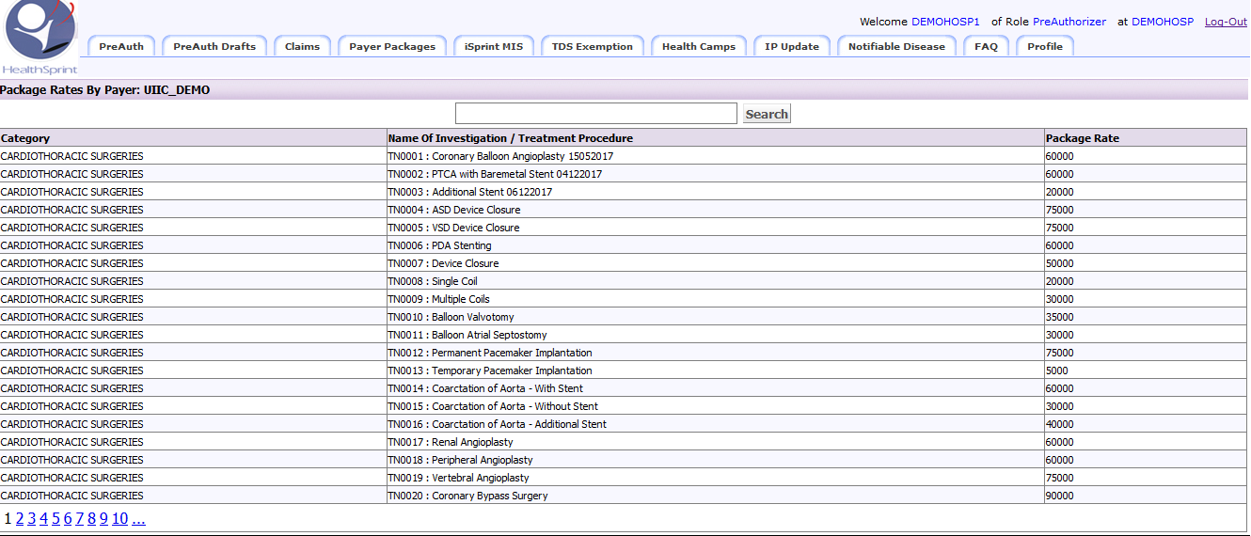
Claims
Payer Package Tab: The packages and Procedure which are available for the hospital will appear here with the rate of the Package.
Package for Autism ->CM0542 : MULTIMODAL THERAPY FOR AUTISM

Slide 53
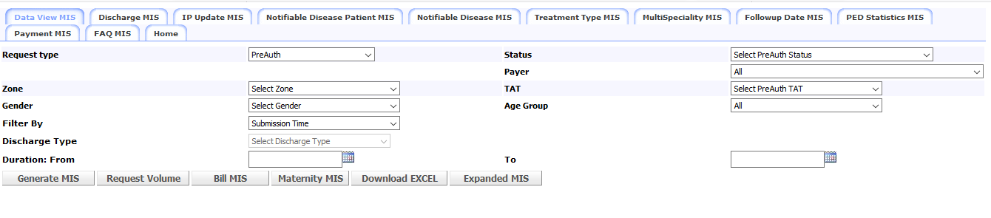
Mis
iSprint MIS Tab:
  The data for the following information can be generated here,
  1.Preauth and Claim report
  2.Discharge datas
  3.Number of Non Scheme patients and CMCHISTN scheme patients.
  4.Notifible disease data
  5.Treatment type,Multispeciality,folloe up data and Payment datas.

Slide 54
THANK YOU

